Slide 1
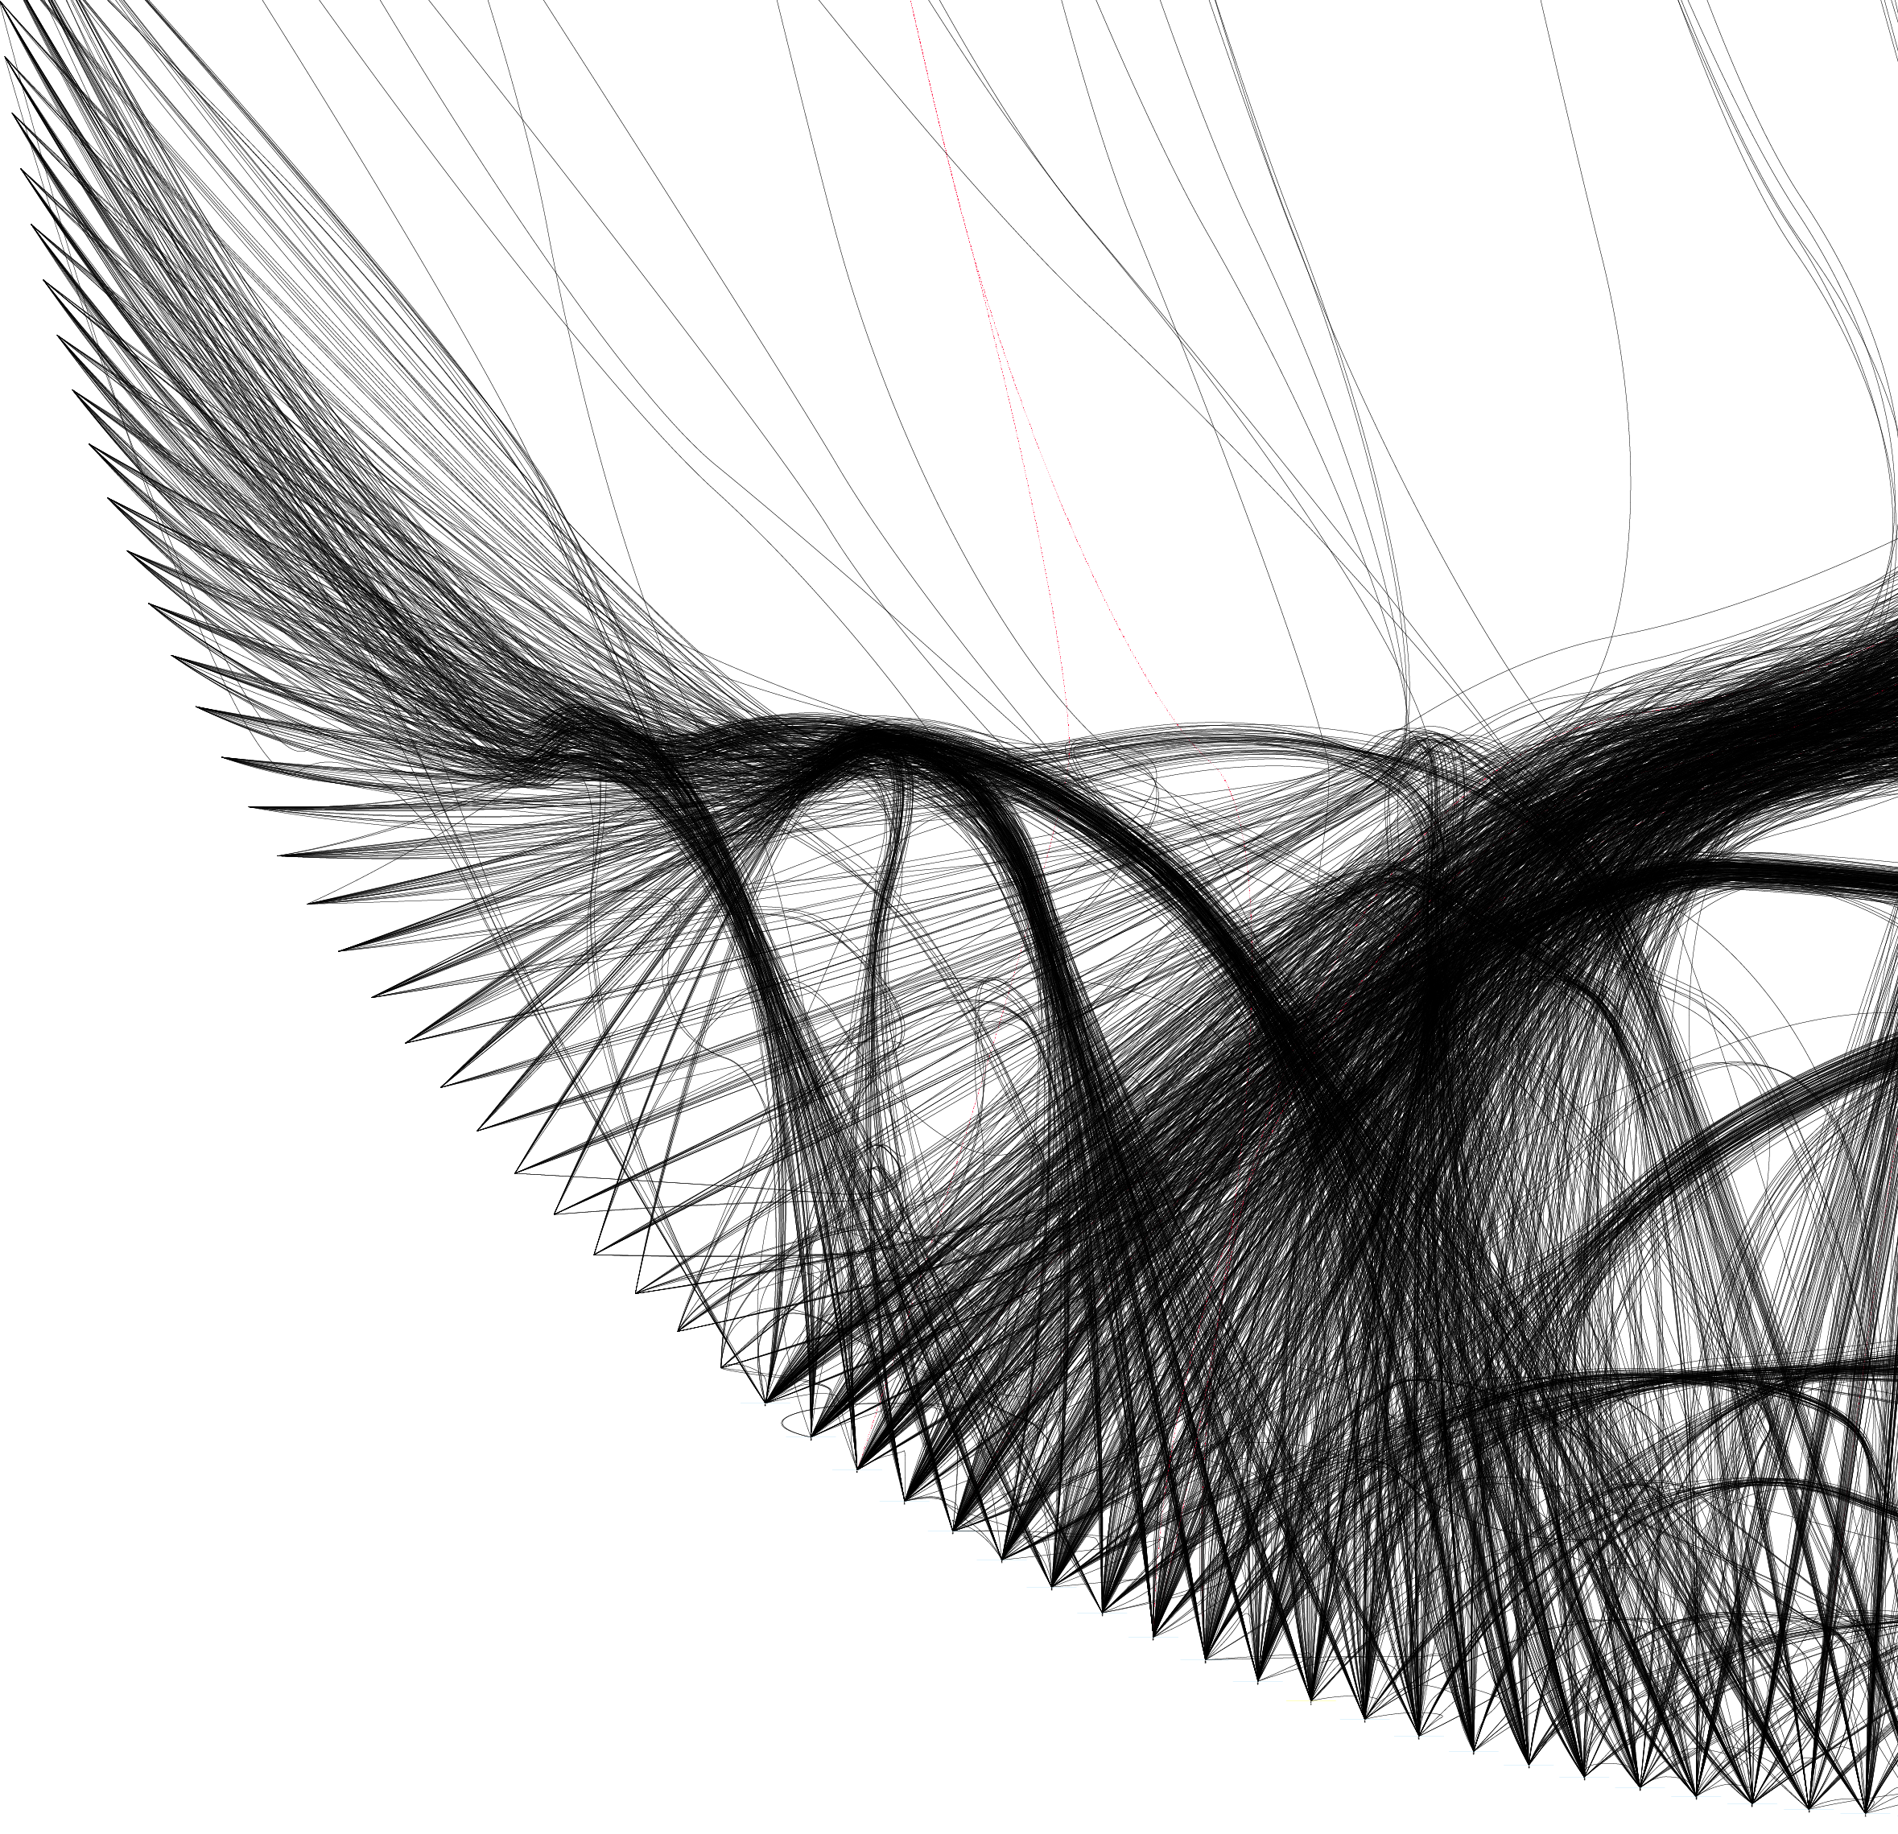

NETWORKS Anders K. Krabberød, University of Oslo

Slide 2
Why Networks?
BackGround
Visualise and analyse high-dimensional datasets with complex distribution
Networks are perfect for exploring relational data
“Six degrees of separation”
Facebook friends
Kevin Bacon game
Structure of internet servers
Exploration of network topology can give insight into associations and interactions between the parts (nodes) in the network

Slide 3
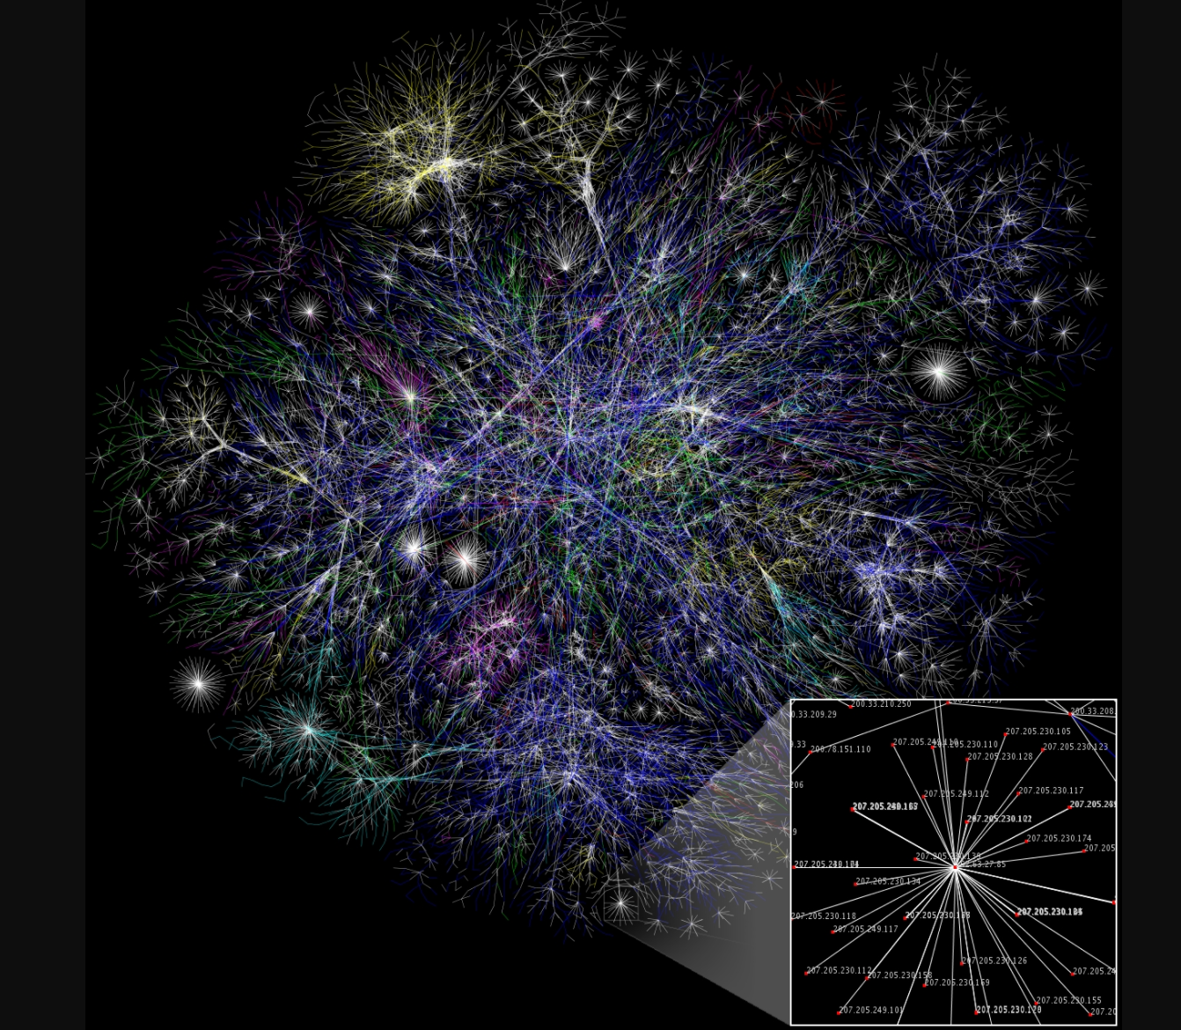
wikimedia

Slide 4
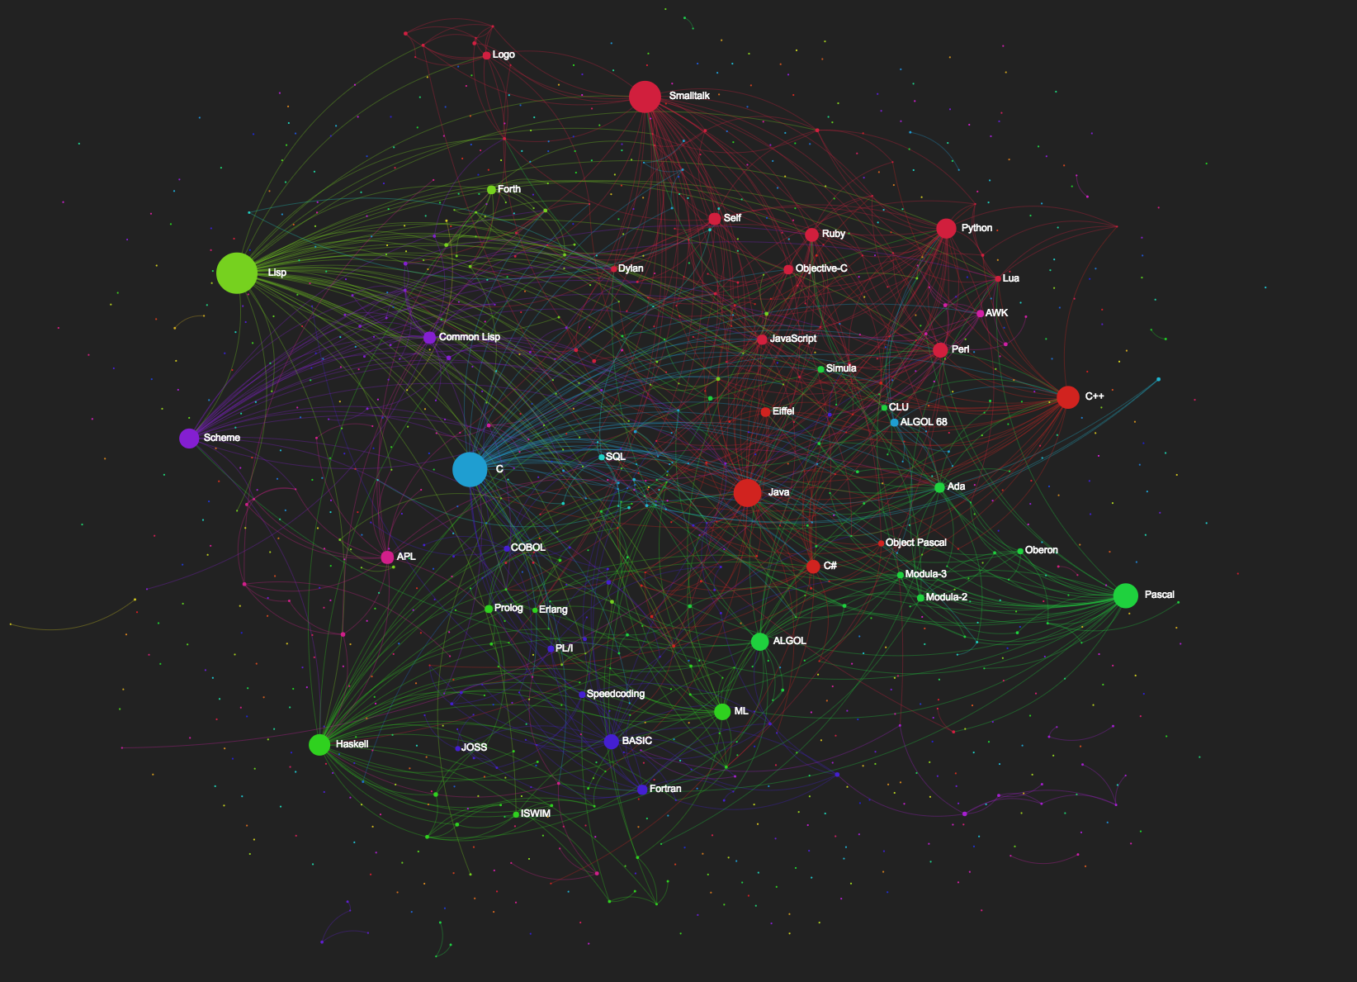

Slide 5
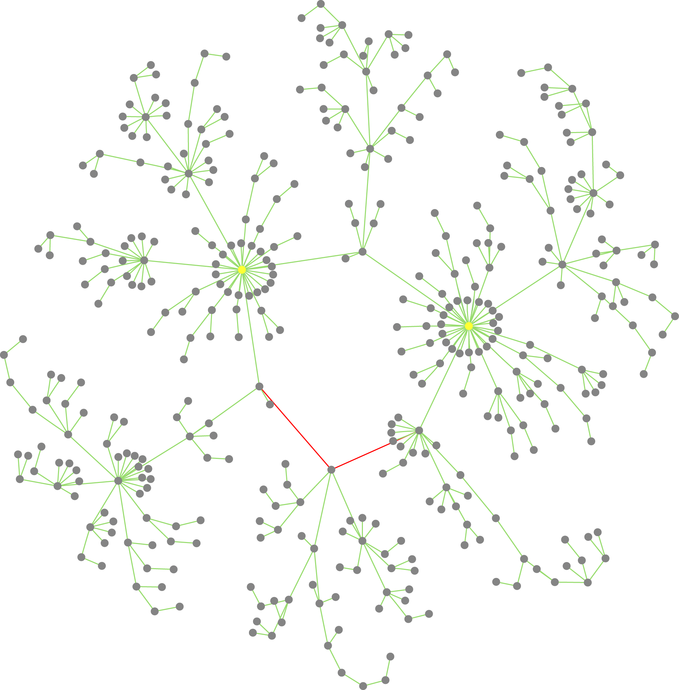
Ecological association networks
Networks can help us find patterns behind small- and large-scale ecological and evolutionary processes
Moving from from identification of parts (species classification, diversity, community composition, geographical distribution etc.) to connections of parts.
Krabberød et al. (2017)

Slide 6
Ecological association networks
Associations/co-occurrence between microbial OTUs/ASVs can reveal:
interactions between organisms, e.g. host/symbiont, prey/predator
similar response to environmental variation
similar niche preference
key species (hubs) and assemblages of interacting species (modules)

Slide 7
Network Features – Some terminology
Networks
Hubs are highly connected nodes, often key species in the network.
Modules: sets of nodes that are more linked to each other than the rest of the network.
Krabberød et al. (2017)

Slide 8
Categories of data for networks
Spatial:
Which OTUs tend to co-occur in similar habitats?
Can cover large geographical areas.
Miss out on seasonal variation and turnover in community composition
Temporal
Same geographic location following microbial communities, and their changes, in time.
Different time-scales have different resolution and will identify different types of interactions
Turn-over for microbial communities can be in the span of days or weeks
Seasonal changes over months and years

Slide 9
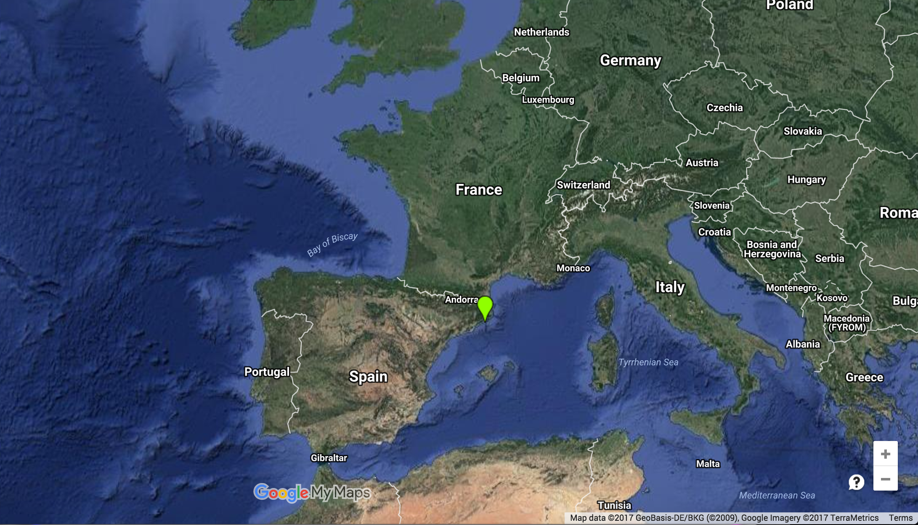
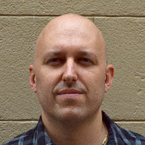

Blanes Bay Marine Observatory
10 years of monthly sampling (120 samples)
DNA from two size fractions
Pico (0.2-3um)
nano (3-20um)
Microbial eukaryotes and bacteria
18 environmental parameters
In collaboration with Ramiro Logares, ICM Barcelona
Ramiro Logares

Slide 10
Similartity analysis
Networks
ELSA – Extended Local Similarity Analysis
Ruan et al (2006) ;Xia et al (2011)
Designed for time series
Detects (local) similarity between potentially shifted or lagged time series
Because it is lagged it returns directed edges (A is shifted with respect to B) and undirected edges (A and B are not shifted)
The maximum allowed time delays/shifts can be specified

Slide 11
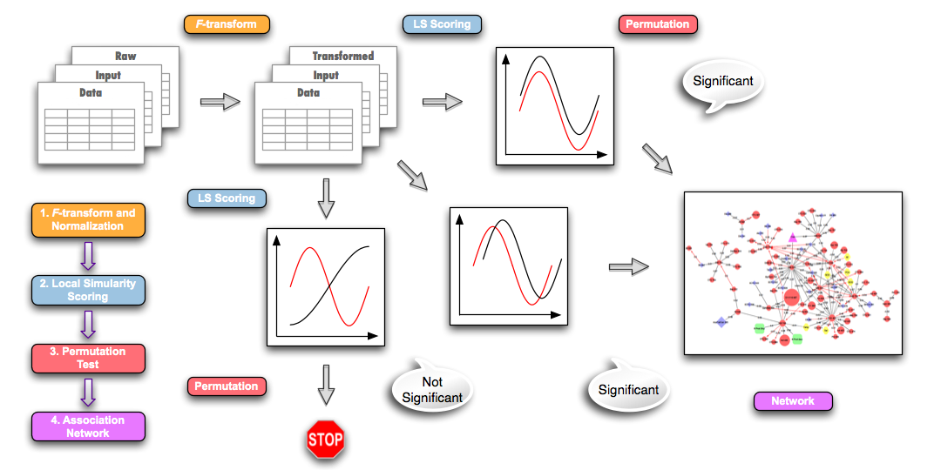
Local Similarity Analysis
Networks
Positive Similarity
Notes:
Data are transformed, and values for missing data are calculated
Pairwise comparison between all OTUs (and OTUs and environmental data)
Designed to pick up complex dependencies between data not necessarily detected by correlation analysis.

Slide 12
Local Similarity Analysis
Networks
Ruan et. al 2006, Xia et al. 2011, 2013
Negative Similarity
Notes:
Data are transformed, and values for missing data are calculated
Pairwise comparison between all OTUs (and OTUs and environmental data)
Designed to pick up complex dependencies between data not necessarily detected by correlation analysis.

Slide 13
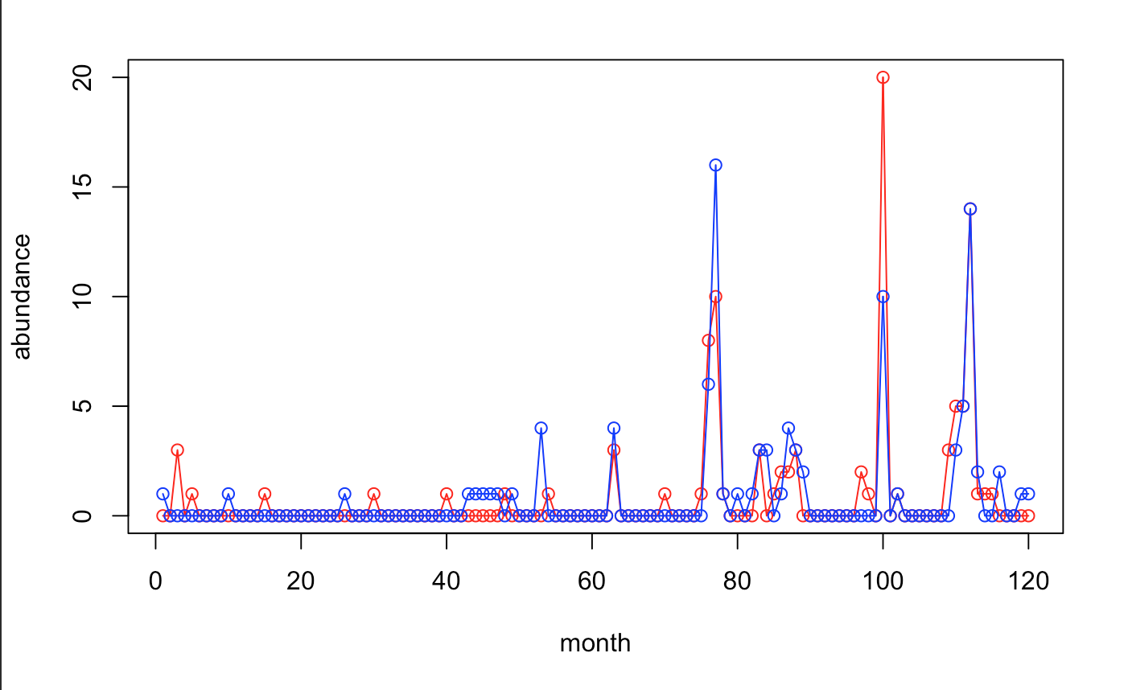
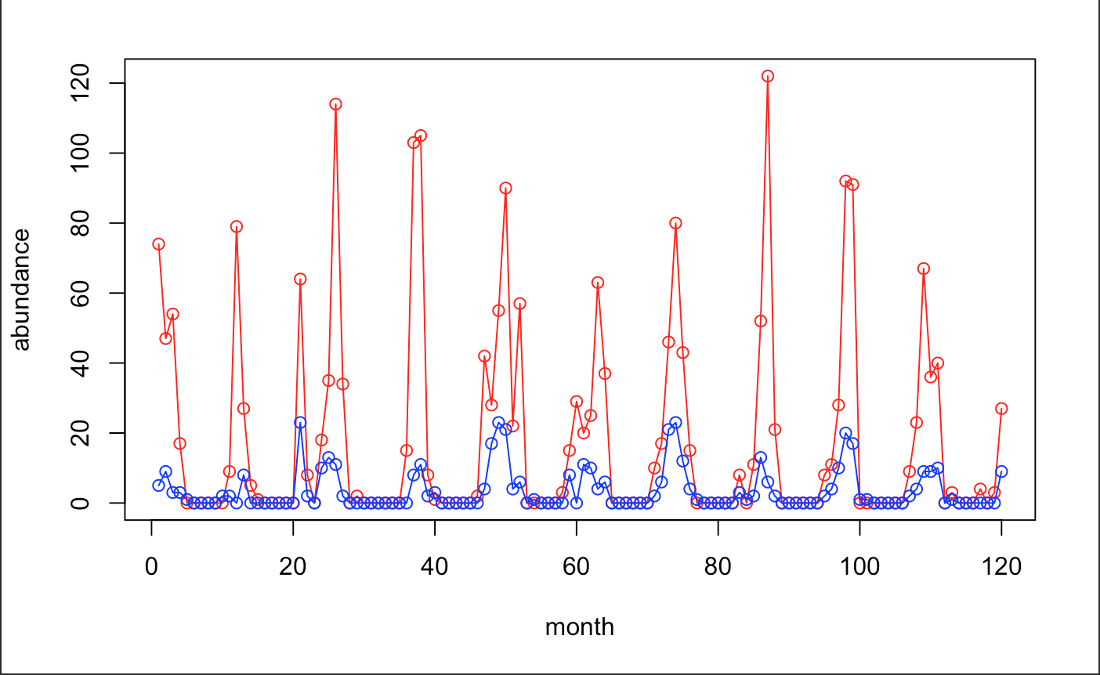
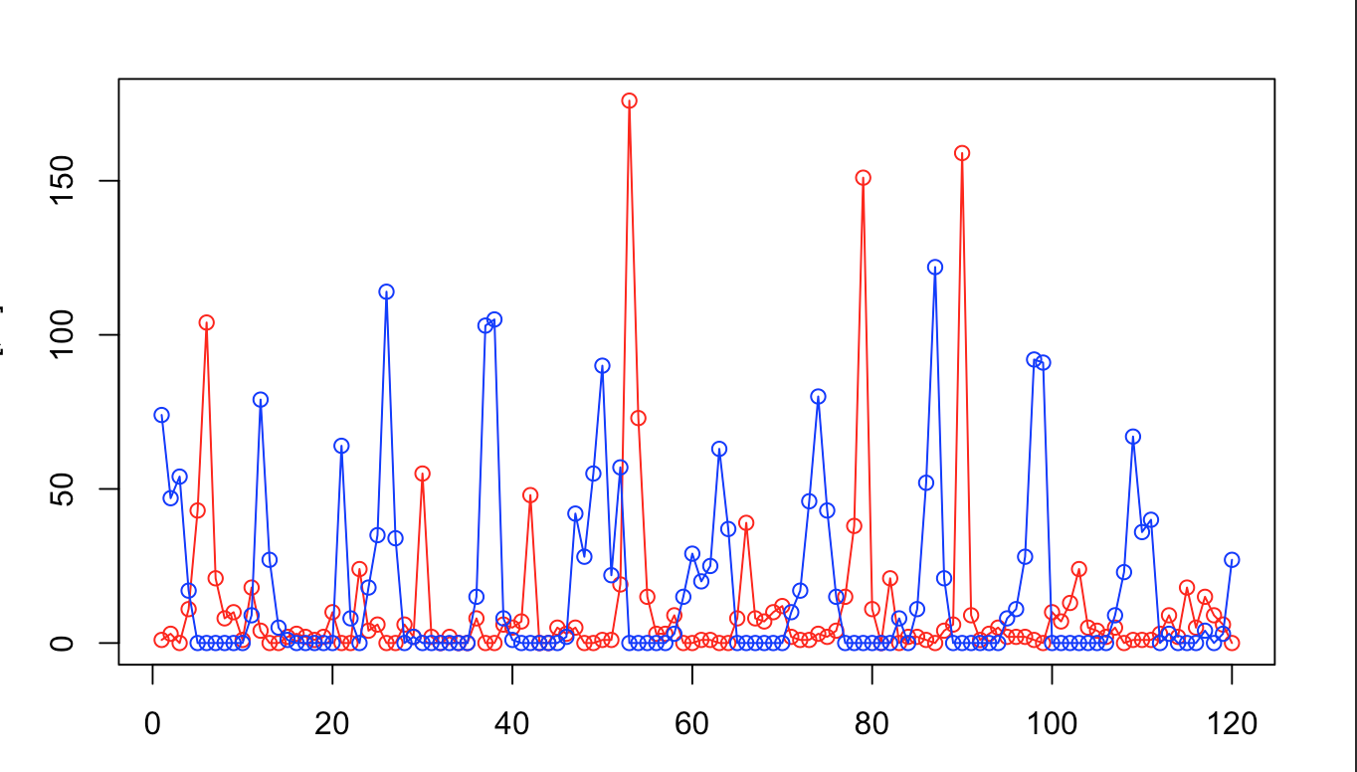
Local Similarity Analysis
Networks
Ruan et. al 2006, Xia et al. 2011, 2013
Local similarity
Notes:
Data are transformed, and values for missing data are calculated
Pairwise comparison between all OTUs (and OTUs and environmental data)
Designed to pick up complex dependencies between data not necessarily detected by correlation analysis.

Slide 14
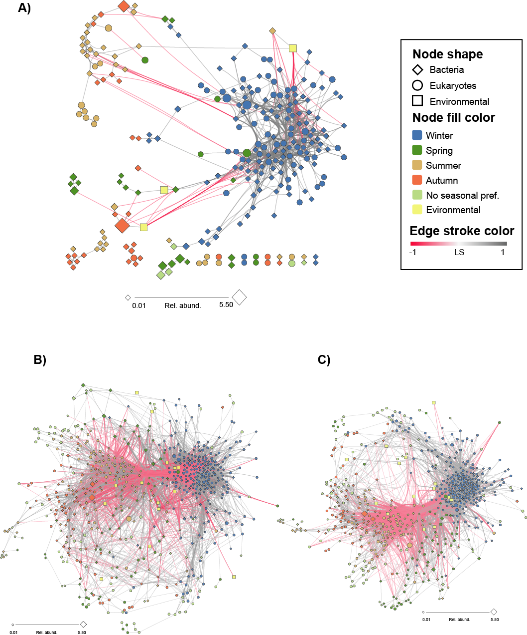
Networks
The resident microbiota
Species in more >30% of the samples.
709 ASVs and 14 environmental parameters
eLSA Without time lags
After removing non-significant edges (P&Q<0.05)
36631 associations (edges)
29663 positive (81%) and
6968 negative (19%)

Slide 15
Core Interactome
Networks
Filtered, and kept the stronge associations:
local similarity score |LS| > 0.7, Spearman correlation |ρ| > 0.7, Bonferroni adjusted p < 0.0001
There are more bacteria species (67.9%) than eukaryotic species
Almost all associations are positive (95 %)
One part is highly interconnected These are ASVs that are more common during the winter season (as calculated by IndVal).

Slide 16
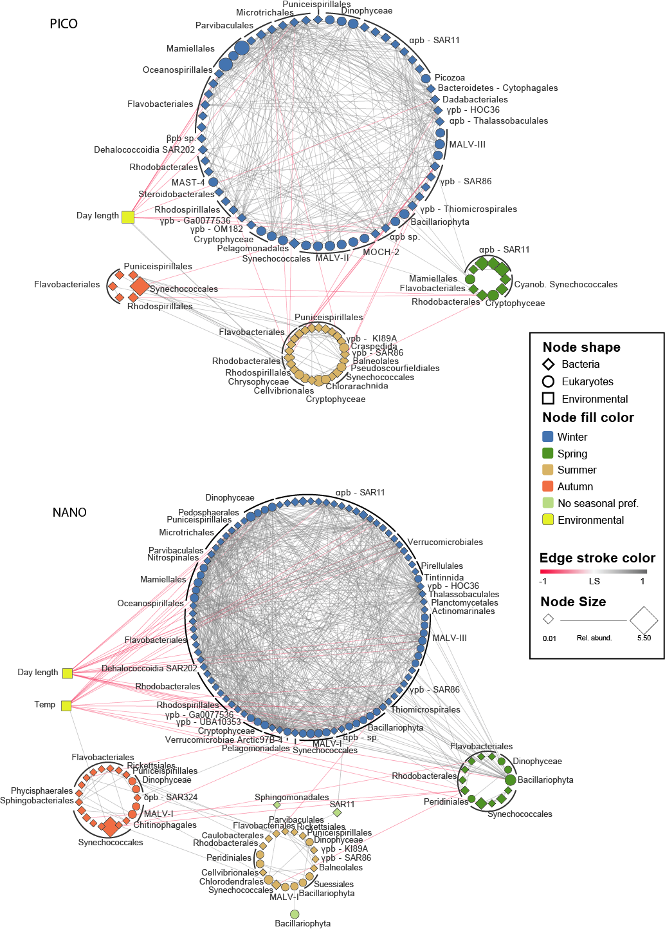
Seasonality
Winter community has the highest proportion of taxa (ASVs) in both size fractions
Winter/spring communities has a higher number of association and are tighter knit (clustering coefficient 0.452), than summer/autumn (cc 0.305)
There is overlapping associations between winter and summer communities.
Summer and autumn are much looser structured

Slide 17
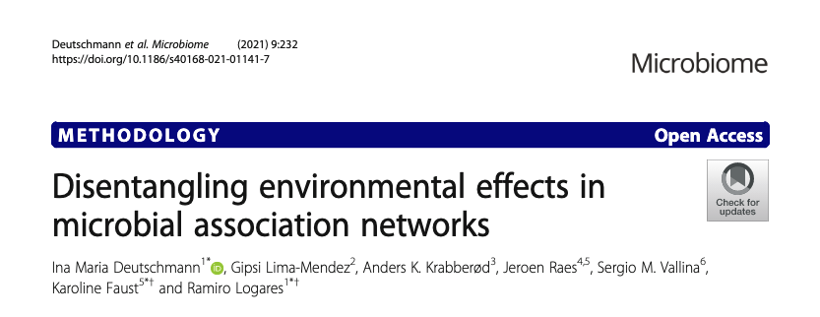
Interactions?
Some of the associations (edges) are due to two organisms reacting to the same environmental variable.
What about direct biotic interactions (symbiosis, parasitism, predation) ?
We spent some effort removing edges in the network that are “indirect” -> caused by two OTUs that co-vary with the same environmental variable
EnDED, Deutschmann (2021)

Slide 18
Validation
Networks
Correlation does not imply causation
Need tools (and/or experiments) to validate associations as interaction
We have built database of protist interactions

Slide 19

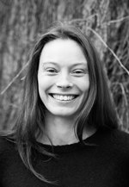
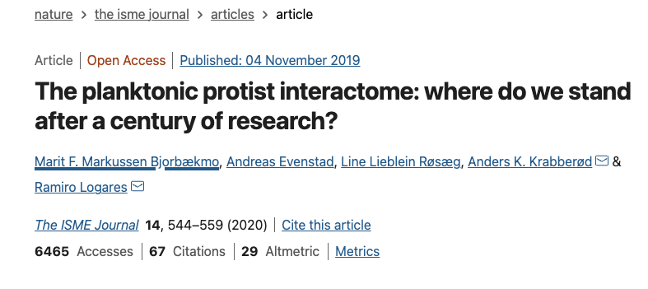
PIDA – Protist interaction database
Networks
We have assembled a database based on known interactions from existing literature and integrated it with other databases
PIDA: Protist interaction database
Github: https://github.com/ramalok/PIDA
﻿The ISME (2019) doi.org/10.1038/s41396-019-0542-5
over 2500 entries from 537 publications
ca 700 species of host and predators
ca 400 species of symbionts and prey
Andreas Evenstad
Marit Bjorbækmo
Line Røsæg
Ramiro Logares

Slide 20
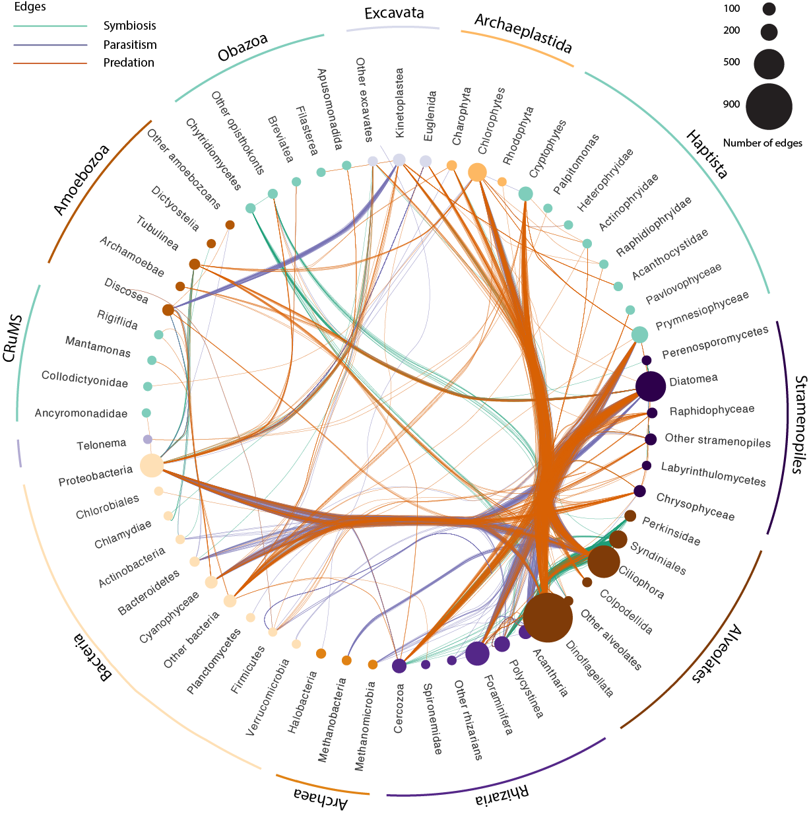
PIDA - summary
Networks
Size of the nodes are proportional to the number of registered interactions.
Diatoms, dinoflagellates, and ciliates have the highest numbers of entries in the database.
Annotate the network from Blanes Bay with interaction information from PIDA
But, there were few matches…

Slide 21
Soil Depth Study
Networks
Sunil Mundra, Håvard Kauserud et al.
Purpose:
Investigate protist, fungus and bacteria at different depths in soil
Soil depth represents a strong physiochemical gradient that greatly affects
Test whether depth-dependent variation in soil chemistry affects the distribution and co-occurrence patterns of microbial communities.

Slide 22
Soil Depth Study
Networks
Four depths at 60 sites
Illumina data from three markers
16S V9 for bacteria
18 V4 for eukaryotes
ITS2 for fungi
Vsearch, 97% for 16S and ITS, 98% for 18S
1540 bacterial OTUs
4388 fungal (3461 ITS-based; 927 18S-based)
2025 micro-eukaryotic

Slide 23
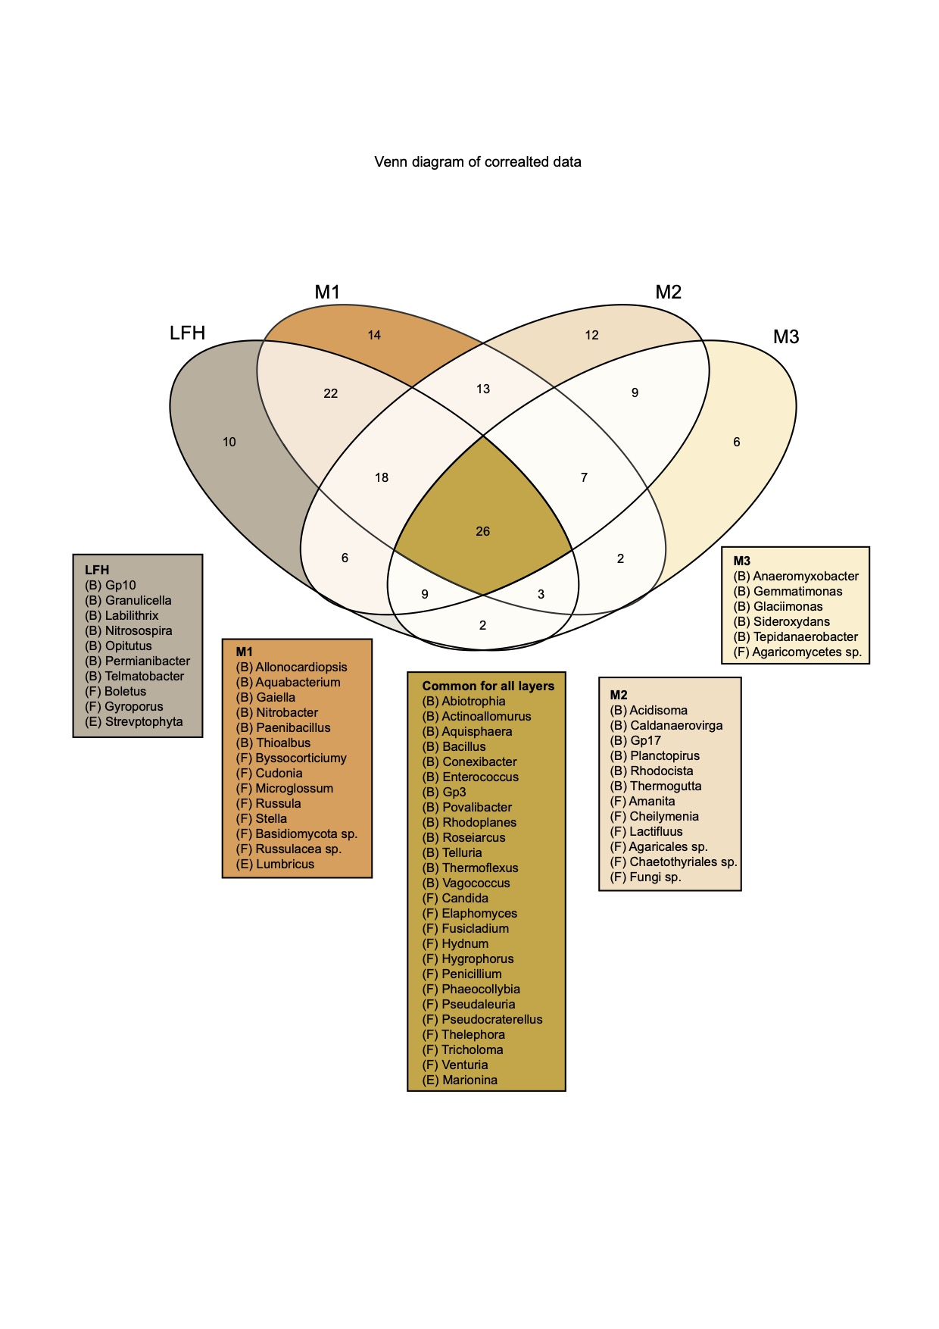
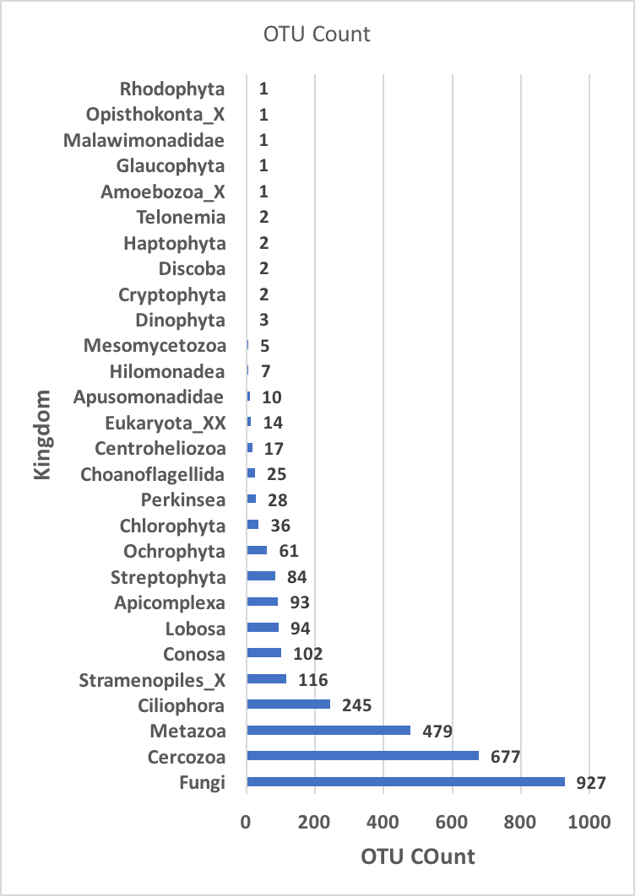
Soil Depth Study
Networks

Slide 24
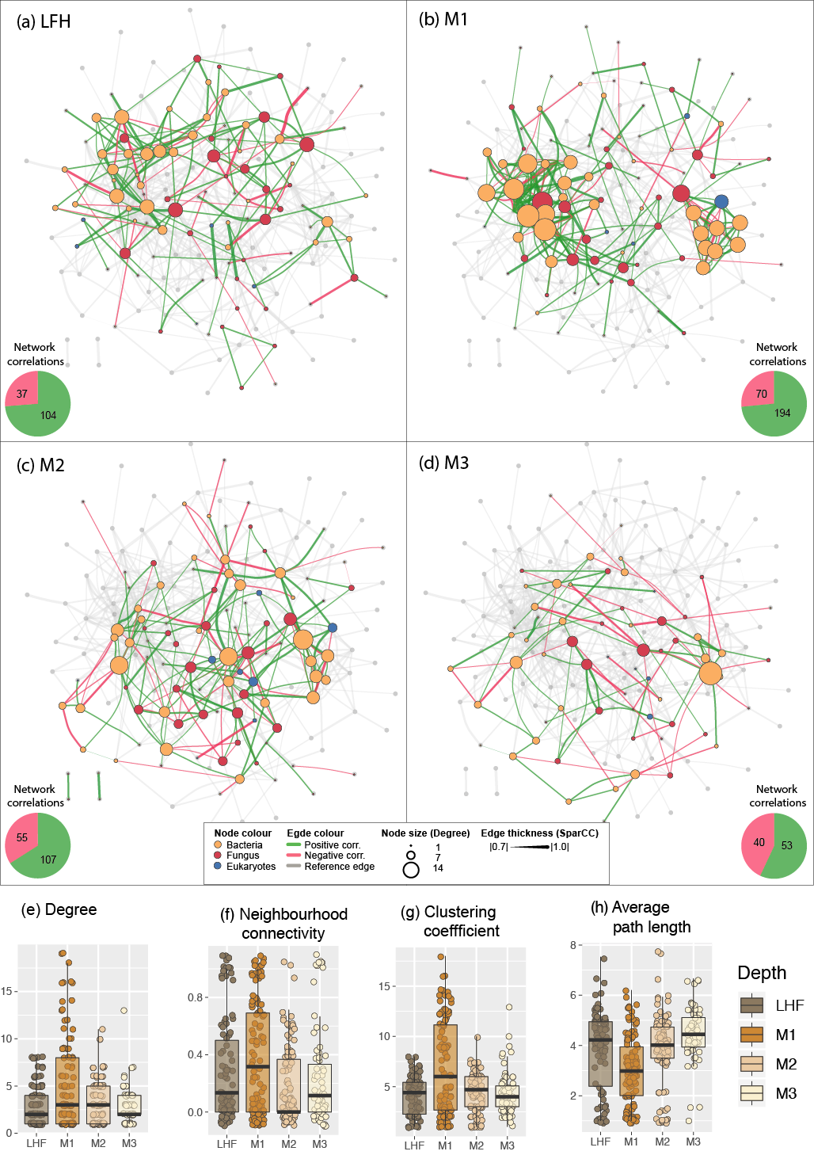
Soil Depth Study
Networks
SparCC networks for each of the four depths.
The network has highest density for the M1 depth (i.e. the first mineral layer)
In the deepest level the proportion of negative occurrences was highest

Slide 25
Soil Depth Study
Networks
SparCC networks for each of the four depths.
The network has highest density for the M1 depth (i.e. the first mineral layer)
In the deepest level the proportion of negative occurrences was highest

Slide 26
Soil Depth Study
Networks
SparCC networks for each of the four depths.
The network has highest density for the M1 depth (i.e. the first mineral layer)
In the deepest level the proportion of negative occurrences was highest

Slide 27
SparCC
Networks
A network algorithm for inferring correlation in sparsely composed data
﻿SparCC (Friedman and Alm, 2012) infers correlations among otus by utilizing log-ratio transformation to eliminate the effect of the total number of read counts, while imposing sparsity of correlations among otu.
Exercise: use the R script for making SparrCC networks on github.

Slide 28
Some Resource
SparCC: a python module for computing correlations in compositional data (16S, metagenomics, etc'). https://bitbucket.org/yonatanf/sparcc
iGraph package for R:
https://www.r-bloggers.com/an-example-of-social-network-analysis-with-r-using-package-igraph/
The code repository for Schmidt et. al 2017 “A Family of Interaction-Adjusted Indices of Community Similarity” doi:10.1038/ismej.2016.139
https://github.com/defleury/Schmidt_et_al_2016_community_similarity/
eLSA: https://bitbucket.org/charade/elsa/wiki/Home
fast eLSA: http://www.cmde.science.ubc.ca/hallam/fastLSA/
Tutorial for WGCNA: https://labs.genetics.ucla.edu/horvath/CoexpressionNetwork/Rpackages/WGCNA/Tutorials/index.html

